Slide 1
KeyLogger Detector
By:- Sakshi Jadhav & sakshi Lanjekar
department of computer Science
Mulund college of commerce (autonomous)

Slide 2
What’s In It For You?
What Is A KeyLogger?
Types Of KeyLoggers
Why Detecting Keylogger Is Important?
How KeyLogger Detector Works?
Demo Video
Limitations
Market Demand Of Keylogger Detector Tools
Future Of Keylogger Detector

Slide 3
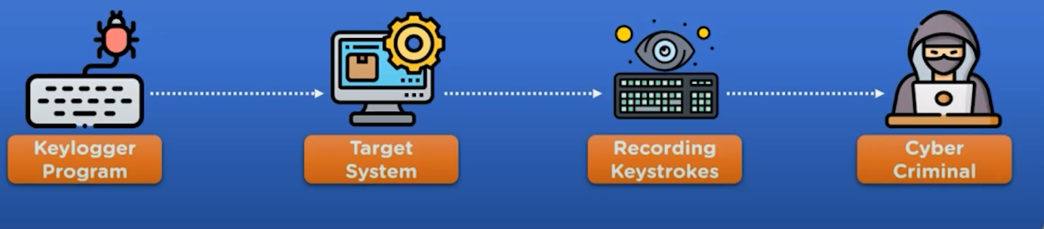
What Is A KeyLogger?
A Keylogger is a program or tool designed to monitor and keep a tab on the “keystrokes” made on a user's keyboard. This enables in compromising sensitive data like, bank details, passwords etc.

Slide 4
Types Of KeyLoggers
Software Based:-Installed as applications or scripts on the system.
Hardware-based:- Physical devices plugged into a computer's keyboard or USB ports that intercept keystrokes.

Slide 5
Why Detecting Keylogger Is Important?
1. Keeps Your Info Safe
2. Protects Your Privacy
3. Stops Money Theft
4. Keeps Your Computer Safe
5. Real-Time Alerts
6. Peace of Mind
7. Less Damage

Slide 6
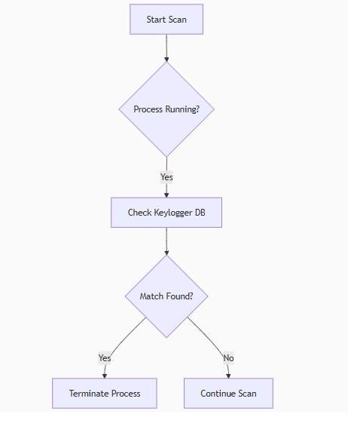
How KeyLogger Detector Works?

Slide 7

Demo Video

Slide 8
Limitations
May not detect advanced or hidden keyloggers.
Focused mainly on simple keylogger types.
Limited to software keyloggers; hardware ones are harder to detect.
Might miss keyloggers that run in the background without obvious signs.
Needs regular updates to catch new keylogging techniques.

Slide 9
Market Demand Of Keylogger Detector Tools
More cyber attacks – As hacking and spying increase, more people and companies need protection from keyloggers.
Online banking and shopping– People use passwords and credit cards online, so they want tools that keep their keystrokes safe.
Work from home– Many employees use personal devices for work, so businesses want to protect them from keyloggers.
Schools and students– Educational institutions need simple tools to teach and protect students from cyber threats.
Growing awareness– More people are learning about digital safety, so they look for easy tools to secure their devices.
Government and businesses – These groups want strong security, including tools that detect spying software like keyloggers.
Mobile and laptop use – Since most people use smartphones and laptops daily, the demand for lightweight keylogger detectors is growing.

Slide 10
Future Of Keylogger Detector
The future of keylogger detector tools looks bright because digital security is becoming more important every day. As more people work online, shop, and share personal data, the need to protect what they type will keep growing. These tools will become smarter, faster, and easier to use, using technologies like AI to detect new and hidden threats. They will also be more common in phones, laptops, and even in business systems. In short, keylogger detectors will be a basic part of everyday cybersecurity in the future.

Slide 11
Conclusion
A Keylogger Detection Tool is essential for protecting your system from a common and dangerous form of cyberattack. It works by using a combination of behavioral analysis, memory scanning, file integrity checks, and network monitoring to detect and prevent keylogging activity. By using a combination of detection and prevention mechanisms, these tools help protect sensitive data and privacy from being stolen by attackers.

Slide 12
THANK YOU!!

